Slide 1
Presentation Title
Sugar Hill Community Profile
And
Broadband Mapping
Sugar Hill Broadband Committee
Carol Miller
National Collaborative for Digital Equity
April 25, 2022

Slide 2
Agenda
Agenda
Who, What, and Why
Broadband Basics
Community Profile
Review Maps
Next Steps
Q&A

Slide 3
Who
Co-owner of NCIA, Berlin for 19 years
Retired from the NH Department of Business and Economic Affairs as the Director of Broadband Technologies for 11 years
National Collaborative of Digital Equity as the Director of Broadband Initiatives since January 2021
Partnered with the NH Municipal Association and the NH Association of Counties

Slide 4
What
Operating a NH Broadband Investment and Planning Network
Providing capacity building facilitation and consulting to cities and towns to improve broadband
Partnership building and sharing information of best practices, business modeling, and digital equity programs for LMI populations

Slide 5
Why
Collect data from Internet Service Providers (ISPs) on service coverage and gaps in your community
Analyze current broadband status and make recommendations on investment in your community
Develop goals and objectives that include strategies to attract partners and investors to upgrade infrastructure by becoming “Broadband Ready”
Preparing cities and towns to take advantage of local, state, and federal resources coming to the State of NH through ARPA and IIJA (BEAD)

Slide 6
What is Broadband
Broadband is a designated speed of data delivery set by the Federal Communications Commission (FCC)
25Mbps download by 3Mbps upload
It is Technology Neutral: wired, and wireless
Many Technologies have capacity constraints
Households today have many users on at the same time
Minimum of 30 Mbps for 2 people
100Mbps – 200Mbps for 3 – 5 people

Slide 7
Status of Broadband in Sugar Hill
Providers: Consolidated Communications, Spectrum, Firstlight, Mt Top Telecom, NH Electric Cooperative
Not one provider covers the entire town
Much of the wire is old and doesn’t support the need for speed in today’s hybrid homes
Unserved areas will have opportunities to improve access with Federal, State, and Local Resources

Slide 8
Sugar Hill Community Profile
17.1 square miles of land and .1 square miles of inland water
50 Miles of Roads
Population 679 and growing
Median Age 58.4 (222 age 55-64)
More females than males (377)

Slide 9
Sugar Hill Community Profile
Total Housing Units 465
Single Family Units 432
Multiple-Family Units available 33
No Mobile Homes

Slide 10
Sugar Hill Community Profile
Per Capita Income $48,820
Median Household Income $88,750
Median Earnings $68,068
8.7% below poverty ($12,880/1, $17,420/2, $21,960/3)

Slide 11
Sugar Hill Community Profile
Civilian Labor Force 349
Employed 344
Unemployed 5
Unemployment rate 1.4%

Slide 12
Sugar Hill Community Profile
Inn at Sunset Hill – Inn with Restaurant
Polly’s Pancake Parlor – Restaurant and Mail Order
Sugar Hill Inn – Inn with Restaurant
Harman’s Cheese & Country Store

Slide 13
Sugar Hill Community Profile
State Routes – 18, 116, 117
Exit 38 off I-93
Working Residents (2019)
61.5% Commute to other Communities
31.3% Work in Community
7.2% Work at Home
70% drive alone

Slide 14
Sugar Hill Community Profile Education
SAU 35
Lafayette Regional Grades K-6 (29 Students)
Profile Grades 7-12 (31 Students)
Career Technology Centers
Hugh J. Gallen Career & Technology Center
White Mountains Regional High School

Slide 15
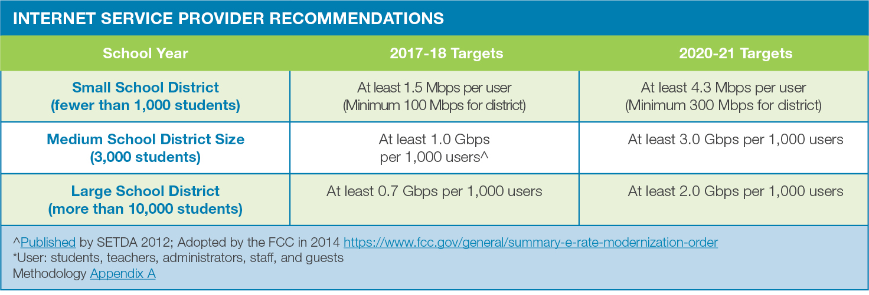
SETDA Recommendations per Student (The State Education Technology Directors Association to promote student-centered learning)

Slide 16
Summary of Educational Impact
Small Local schools should at least have a 300 Mbps to the Internet
Lafayette Regional Grades K-6
200 Mbps/Cable for 118 Students
Profile School Grades 7-12
200 Mbps/Cable for 219 Students

Slide 17
Summary
Broadband Mapping and Next Steps

Slide 18
Q&A
Carol Miller
NCDE
603-723-4850
cmiller@digitalequity.us
www.digitalequity.us

